Slide 1
Impact Evaluation with DHIS2
Instructions for preparing and analyzing data
John Painter
July 28, 2021

Slide 2
Overview
Reduce noise and reporting bias by cleaning data and filtering to facilities that reported each month
Find variables to download
Download 5 years of data
Pre-intervention, model data and identify inherent variability
Post-intervention, predict counterfactual – what was expected without intervention
Estimate percent change following intervention and determine if it is different from inherent variability

Slide 3
Process: Scripts and Apps
Magic Glasses app (formerly ‘dataDictionary’) to download
metadata of DHSI2 data elements, category options combos, indicators (numerator and denominator details), organization units (names and coordinates)
identify data elements and category option codes for each indicator (formula)
Formula Data Downloads.R to download data for all admin units (facilities, districts, etc.), each month (week) for last 5 years
Can re-run script to update data. In addition to new months, script checks each previous month to see if data on server is different than data previously downloaded; if yes, will re-download that month.
DQA Modeling.R to clean and organize data
Convert to tidy time-series format (tsibble)
Scan each data-element, category combo, from each facility, and remove outliers when values exceed median absolute deviation limit and when error of seasonally fit model exceeds mean error + 3sd.
Save file with original data, outlier flags, and column of ‘cleaned’ data that has outliers set to missing

Slide 4
Process: Scripts and Apps
Trend Viewer.Rmd shiny app
Reporting Tab
Visualize data and results of cleaning
Identify facilities with consistent reporting
Subset of data up and down ladder of organizational hierarchy (National, Regional, District, Sub-district, facility)
Trend Tab
Pre-intervention, identify the model that has the smallest difference between predicted and observed – smallest mean absolute percent error (MAPE). This represents the inherent noise in the data-model.
Post-intervention, the impact of intervention is estimated as the difference between values model predicted (assuming no intervention) and observed values (with intervention). Impact may be positive or negative.
View probability that change was not zero, and probability that change was different from the inherent noise in the data-model. (not yet implemented in the app)

Slide 5
Step-by-step details
Pre-requisites
Identify data for analyses
Create formula

Slide 6
Pre-requisites
Install R, Rstudio, and GIT
In Rstudio, start new project from git
Link to git repository https://github.com/jpainter/dataDictionary.git
Similarly, start another new project from git
Link to git repository https://github.com/jpainter/dataTime.git
Set up folder to store data and results
Example: c:/myDocuments/Impact/Guinea
Later, we refer to a root folder (e.g. c:/myDocuments/Impact) and a country folder (Guinea)

Slide 7
Identify Data for Analysis
Go to project dataDictionary
Open and run app.r (this starts a shiny app ‘Magic Glasses’)
In the shiny app, provide url and credentials for DHIS2 instance
For quicker access, can store login details in file _instances.xlsx
Request metadata
-> when request complete and screen shows metadata, download the metadata file to the country folder
Browse variables in Malaria Relevant Data Elements (and if don’t see what you are looking for, in Data Elements)

Slide 8
Create Formula
A formula provides the specific details for the data to include in analysis. This defines the data elements and category combinations to download. Later, we can analyze the total, or each element/category separately.
Example:
Formula Name: “confirmed cases”
[opd cases confirmed by RDT].[<5 yrs] + [opd cases confirmed by RDT].[5 yrs+] +
[ipd cases confirmed by RDT].[<5 yrs] + [ipd cases confirmed by RDT].[5 yrs+] +
[chw cases confirmed by RDT].[<5 yrs] + [chw cases confirmed by RDT].[5 yrs+]
Select Formulas from index on left side of app
Add formula name, filter elements, click to add each to formula,
Save and download formula file to the country data folder

Slide 9
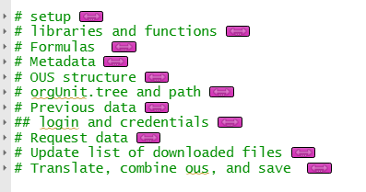
Download Data
Open Formula Data Downloads.R
At top of file (under setup), fill in NULL values.
Example: country = NULL country = "DRC"
country.dir = NULL country.dir = ‘C:/Users/bzp3/Projects/DRC’
[ note: In R, single backslash (\) slashes need to be replaced with either double back slash (\\), or forward slash(/) ]
Run the code in rest of document
Shortcut: Collapse each sub-heading,
highlight and hit ctrl+enter keys
Output is one data file per formula, e.g.
DRC_Malaria deaths_All levels_201601_202107_2021-07-13_formulaData.rds
C
C
date range of data
download date

Slide 10
Clean Data
Open DQA Modeling.R
In Setup, fill in country and country.dir values
Run each of the code blocks except for the parts below UNDER DEVELOPMENT
Output is a series of files e.g.,
DRC_Malaria deaths_All levels_201601_202107_2021-07-13_formulaData.dTs.rds (after conversion to time-series format and MAD outliers)
DRC_Malaria deaths_All levels_201601_202107_2021-07-13_formulaData.dTs_Seasonal.rds (after detecting seasonal outliers)

Slide 11
View and Model Data for Impact Evaluation part 1: load data from previous step
Open and run Trend Viewer.Rmd
Go to Data tab (top) to specify folder that has data files, and to select an Indicator (the names of formulas)
May take a minute to load data while opening the …Seasonal.rds file from previous step
On left pane,
select one or more from DataElement/Category. {note this box will be empty until data from previous step is loaded}.
Select multiple elements/categories by clicking each, or selecting the box, Total all categories.
Choose original or cleaned data from Original/Cleaned

Slide 12
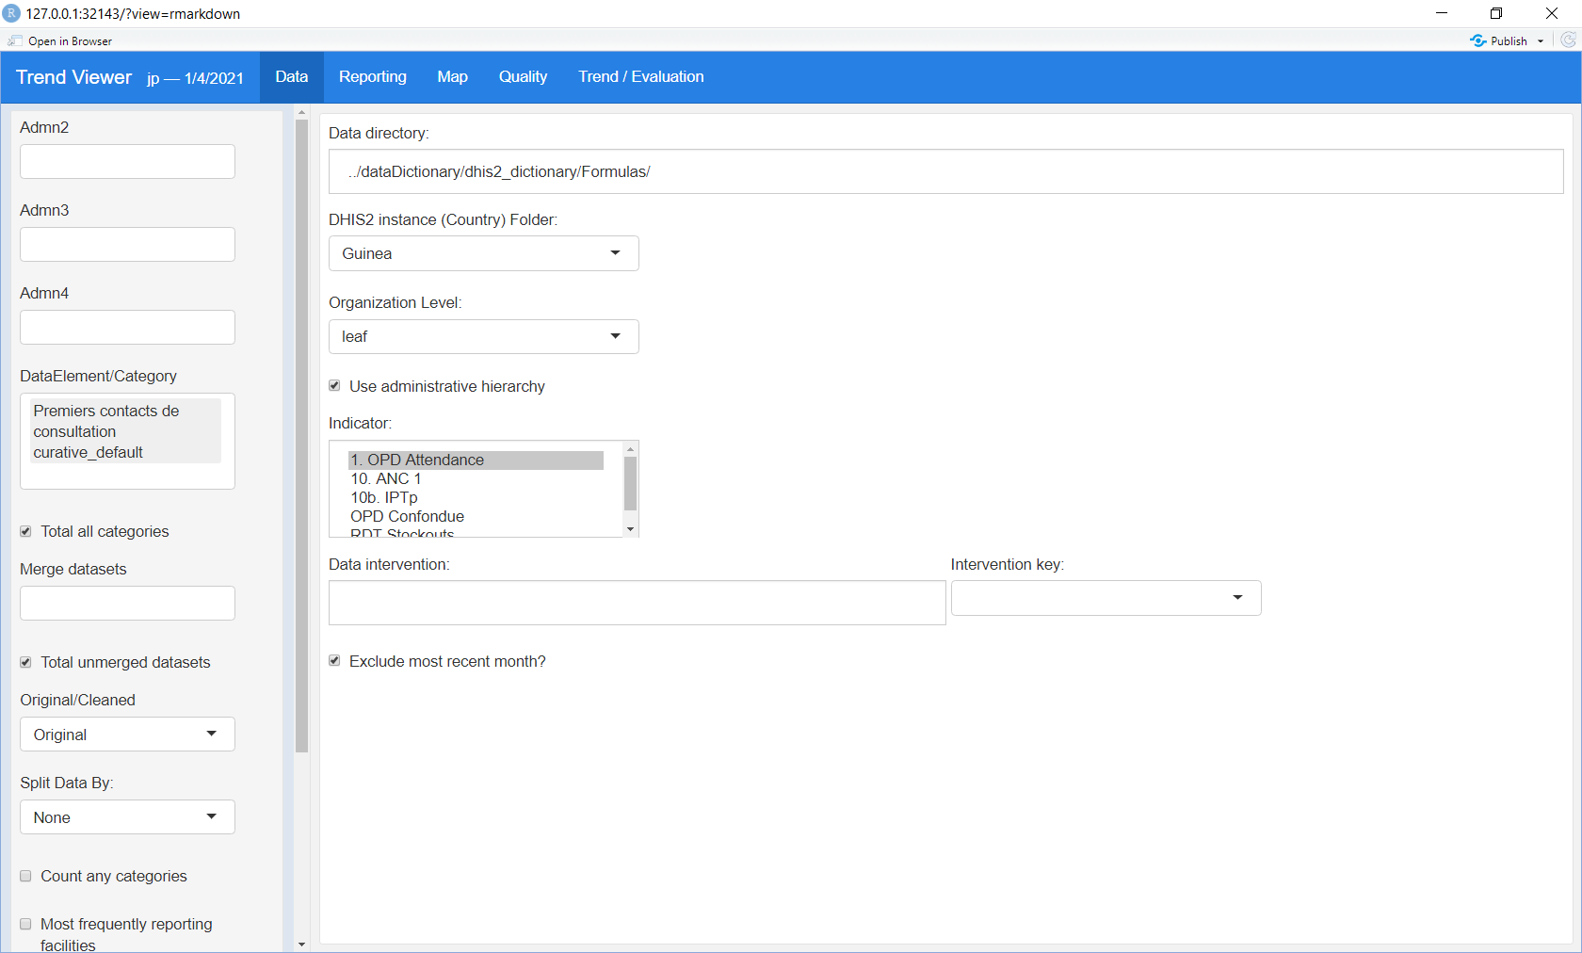
View and Model Data for Impact Evaluation part 1: load data from previous step
Data folder (not including the country folder)
Country (sub-folder of above)
DataElement/Category
Indicator

Slide 13
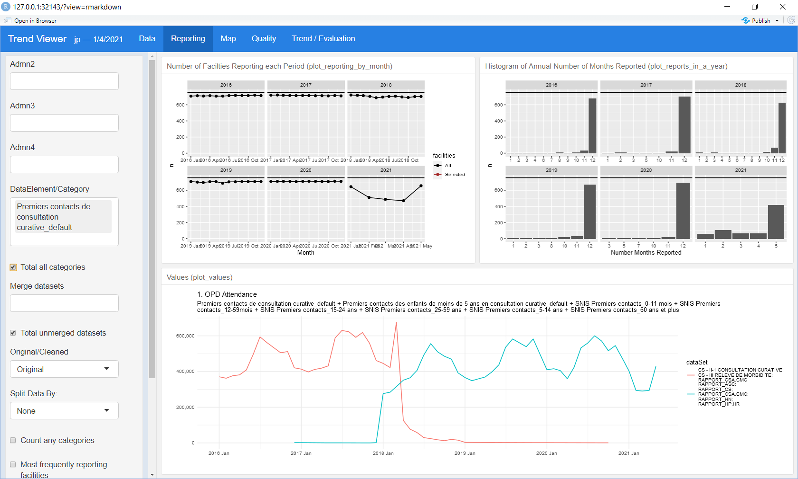
View and Model Data for Impact Evaluation part 2: Review reporting and select facilities with consistent reporting
Go to Reporting tab (top)
If data from more than one dataset, as shown in this example, some facilities may have reported data to both dataset on the same month. Combine these by selecting both datasets in the box Merge datasets
Select Most frequently reporting facilities to view the impact of inconsistent reporting

Slide 14
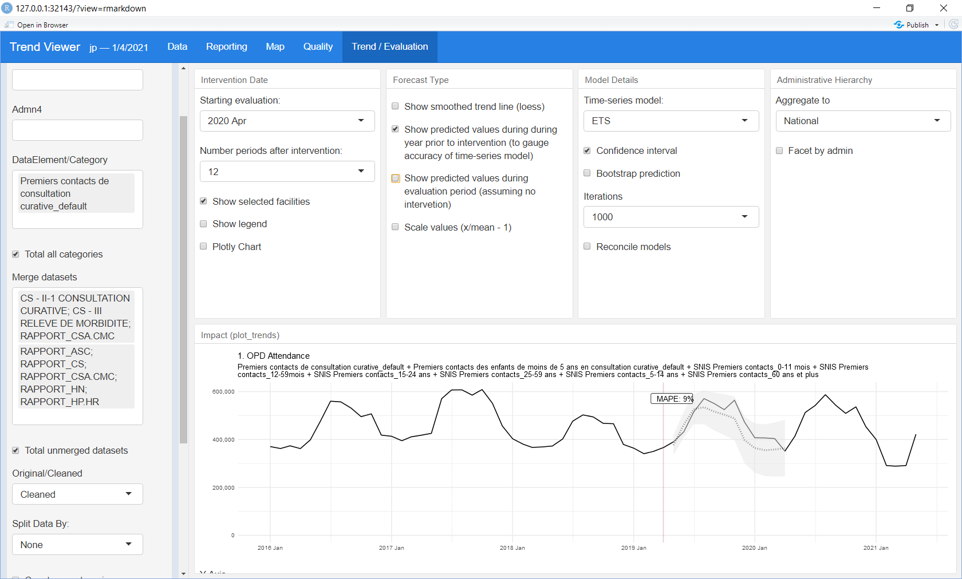
View and Model Data for Impact Evaluation part 3: Estimate change after a month (e.g. impact after an intervention)
Go to Trend/Evaluation tab (top)
Select Starting evaluation time-point
Select Predicted values during year prior to intervention with different Time-series models (choose best) based on the mean absolute percent error (MAPE ), the difference between the predicted and observed in this period. MAPE is a good indicator of 1. model fit, 2. the magnitude of natural variation in the data.

Slide 15
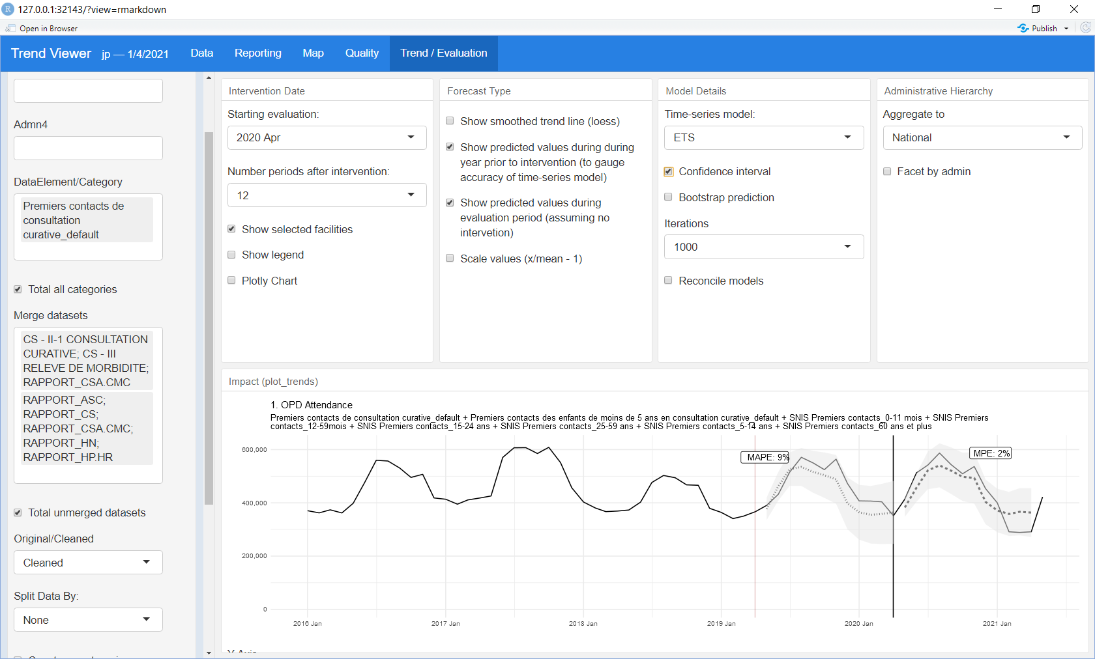
View and Model Data for Impact Evaluation part 3: Estimate change after a month (e.g. impact after an intervention)
Go to Trend/Evaluation tab (top)
Select Predicted values during evaluation period to estimate the mean percent error (MPE), the difference between predicted and observed. If the MPE during the evaluation is less than the MAPE during the pre-valuation period, the MPE may not be statistically significant. (a reasonable heuristic that should be followed with statistically valid significance testing…)

Slide 16
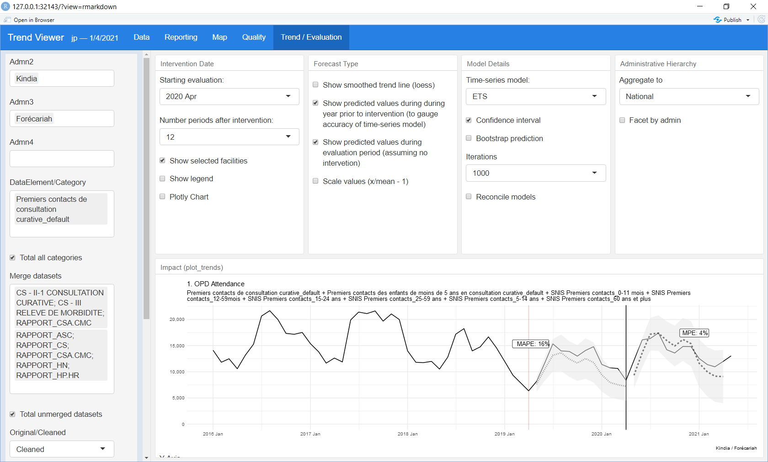
View and Model Data for Impact Evaluation part 3: Estimate change after a month (e.g. impact after an intervention)
Drill down to regions, sub-regions, etc.
Admn2 (e.g. Regions)
Admn3 (e.g. Regions)
Indicates regions in chart

Slide 17
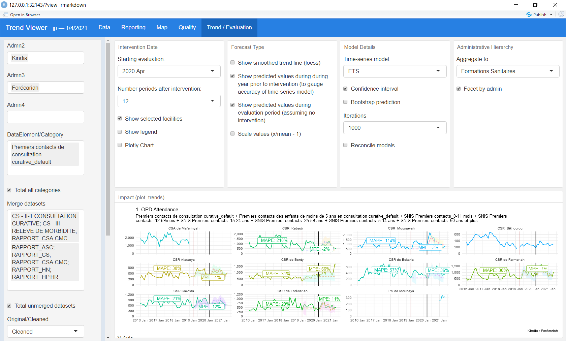
View and Model Data for Impact Evaluation part 3: Estimate change after a month (e.g. impact after an intervention)
View all orgunits within selected area
Select level to Aggregate and display data
Display data as separate Facet for each admin/orgunit

Slide 18
Extras Skill Builders… How to convert .rds file to .csv and .xlsx
# read the file and then save it as .csv
x = readRDS(“data.rds")
write.csv( x, "data.csv" )
# save as Excel
library( openxlsx )
wb <- createWorkbook()
sheet1 <- addWorksheet( wb, sheetName = "data")
writeDataTable( wb, sheet1, x , rowNames = FALSE)
# to add more sheets, repeat two previous lines (changing names, of course)
saveWorkbook( wb , "data.xlsx" , overwrite = TRUE )

